Slide 1


LLMPirate: LLMs for Black-box Hardware IP Piracy
Vasudev Gohil
Matthew DeLorenzo
Veera Vishwa Achuta Sai Venkat Nallam
Joey See
Jeyavijayan Rajendran

Slide 2

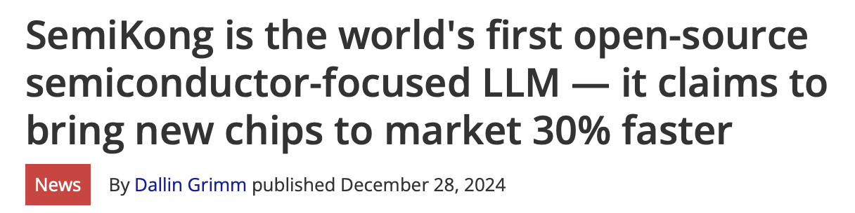
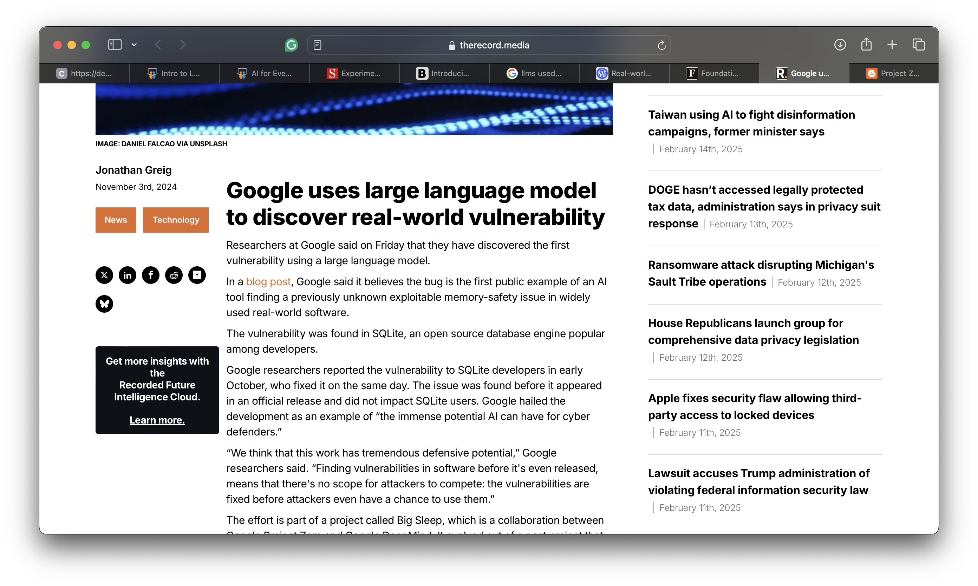
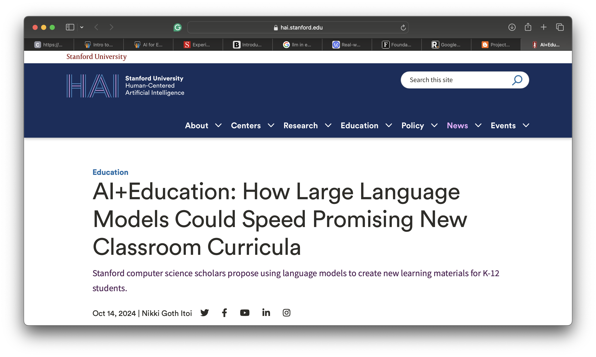

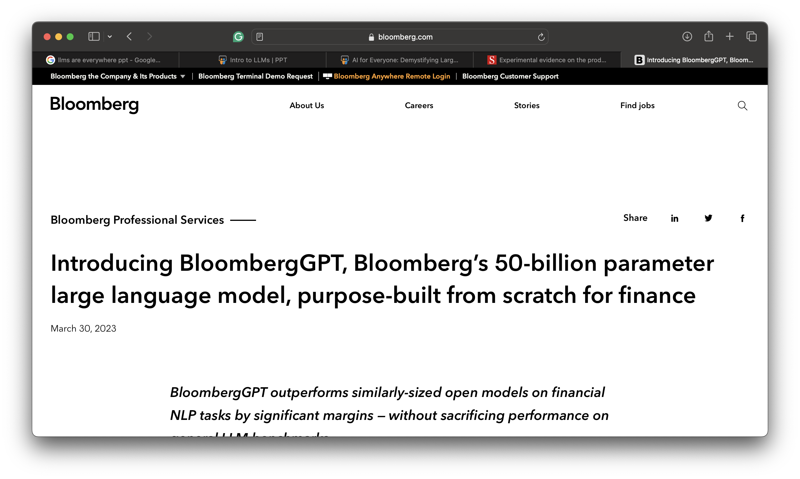
LLMs are Everywhere

Slide 3

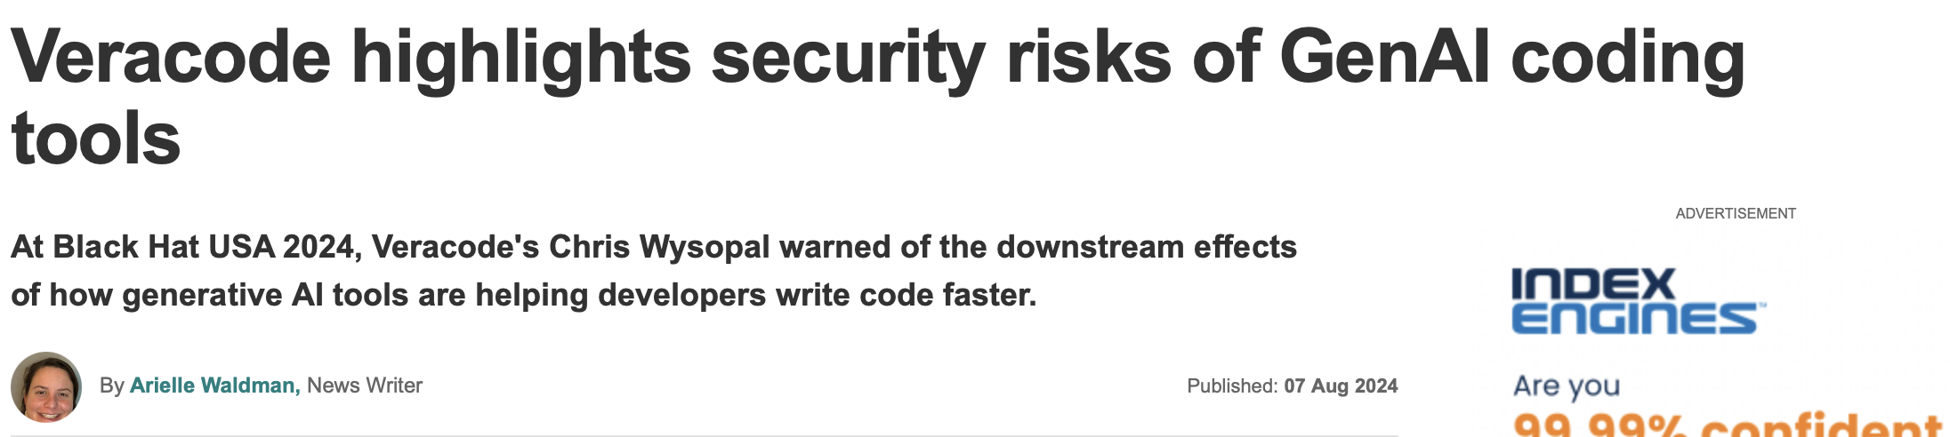
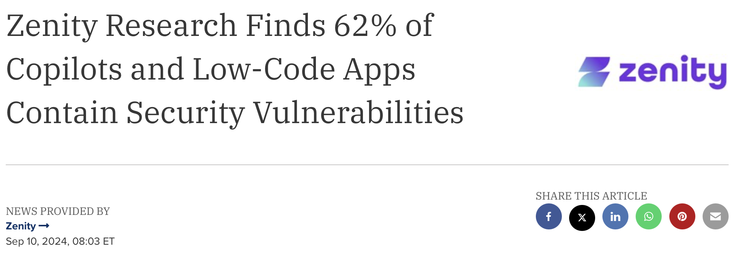
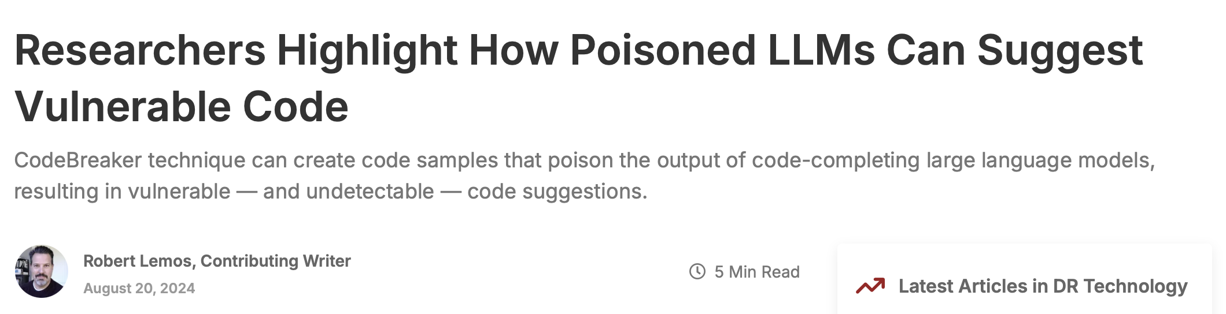
LLM-related Attack Vectors

Slide 4
LLM-related Attack Vectors
Can LLMs Successfully Pirate Hardware Intellectual Property (IP)?

Slide 5
LLM-related Attack Vectors
Can LLMs Successfully Pirate Hardware Intellectual Property (IP)?
LLMPirate: LLMs for Black-box Hardware IP Piracy

Slide 6

Threat Model
No Modifications
Piracy Detector

Slide 7


Threat Model
LLM
Original Netlist
Pirated Netlist
No Modifications
Functionally-equivalent Transformations
Piracy Detector

Slide 8
Threat Model
LLM
Original Netlist
Pirated Netlist
No Modifications
Functionally-equivalent Transformations
Piracy Detector
Black-box Access

Slide 9

Threat Model
LLM
Original Netlist
Pirated Netlist
No Modifications
Functionally-equivalent Transformations
Piracy Detector
Black-box Access
Goal: Evade Detection

Slide 10
LLMPirate – Preliminary Formulation
Verilog Netlist
Response

Slide 11

LLMPirate – Challenges and Solutions
Verilog Netlist
Response
①
Difficulty Understanding Verilog Netlists

Slide 12
LLMPirate – Challenges and Solutions
Verilog Netlist
Response
①
Difficulty Understanding Verilog Netlists
Ⓐ Prompt Syntax Translation to Circuits

Slide 13
LLMPirate – Challenges and Solutions
Scalability Issues with Large Circuits
②
Verilog Netlist
Response
①
Difficulty Understanding Verilog Netlists
Ⓐ Prompt Syntax Translation to Circuits

Slide 14
LLMPirate – Challenges and Solutions
Ⓑ Pre-characterization and Divide-and-conquer
Scalability Issues with Large Circuits
②
Verilog Netlist
Response
①
Difficulty Understanding Verilog Netlists
Ⓐ Prompt Syntax Translation to Circuits

Slide 15
LLMPirate – Challenges and Solutions
Ⓑ Pre-characterization and Divide-and-conquer
Scalability Issues with Large Circuits
②
Verilog Netlist
Response
①
③
Difficulty Understanding Verilog Netlists
Ⓐ Prompt Syntax Translation to Circuits
Error-prone Responses

Slide 16
LLMPirate – Challenges and Solutions
Ⓑ Pre-characterization and Divide-and-conquer
Scalability Issues with Large Circuits
②
Verilog Netlist
Response
①
③
Difficulty Understanding Verilog Netlists
Ⓐ Prompt Syntax Translation to Circuits
Error-prone Responses
Ⓒ Feedback-based Formulation

Slide 17
LLMPirate – Putting It All Together

Slide 18
LLMPirate – Putting It All Together

Slide 19
LLMPirate – Putting It All Together

Slide 20
LLMPirate – Putting It All Together

Slide 21
LLMPirate – Putting It All Together

Slide 22
Main Results
LLMPirate Successfully Evades All Detection Tools

Slide 23
Ablation Study
# Successes (Sim. Score) | GNN4IP [1] | MOSS [2] | Jplag [3] | SIM [4]
LLMPirate\ Solution Ⓐ | 0 (N/A) | 0 (N/A) | 0 (N/A) | 0 (N/A)
LLMPirate\ Solution Ⓑ | 0 (N/A) | 0 (N/A) | 0 (N/A) | 0 (N/A)
LLMPirate\ Solution Ⓒ | 32 (-0.75) | 32 (0.01) | 32 (0.20) | 7 (0.32)
LLMPirate | 32 (-0.88) | 32 (0.01) | 32 (0.13) | 26 (0.27)
Solution Ⓐ > Solution Ⓑ >>> Solution Ⓒ

Slide 24
Key Findings
Model Size Matters
GPT-4 and CoPilot achieve the best performance in successfully pirating netlists
CodeLlama-13B performs significantly better than the smaller CodeLlama-7B

Slide 25
Key Findings
Model Size Matters
GPT-4 and CoPilot achieve the best performance in successfully pirating netlists
CodeLlama-13B performs significantly better than the smaller CodeLlama-7B
Training Data Size Matters
Latest version of Llama (Llama3-8B) outperforms the older Llama2 models

Slide 26
Key Findings
Model Size Matters
GPT-4 and CoPilot achieve the best performance in successfully pirating netlists
CodeLlama-13B performs significantly better than the smaller CodeLlama-7B
Training Data Size Matters
Latest version of Llama (Llama3-8B) outperforms the older Llama2 models
Feedback Improves Performance
With proper feedback and multiple attempts, smaller LLMs correct their mistakes

Slide 27
Thank You
Vasudev Gohil
vasudevgohil.com

Slide 28
References
[1] Yasaei, Rozhin, Shih-Yuan Yu, Emad Kasaeyan Naeini, and Mohammad Abdullah Al Faruque. “GNN4IP: Graph neural network for hardware intellectual property piracy detection.” In 2021 58th ACM/IEEE Design Automation Conference (DAC), pp. 217-222. IEEE, 2021.
[2] Aiken, Alex. “A System for Detecting Software Similarity.” https://theory.stanford.edu/~aiken/moss/
[3] Jplag. “JPlag - Detecting Software Plagiarism.” https://github.com/jplag/JPlag
[4] Grune, Dick. “The software and text similarity tester SIM.” https://dickgrune.com/Programs/similarity_ tester/

